Slide 1


Welcome to the
Compressed Gas & Equipment Safety Seminar

Slide 2
Garfield Heights, OH
Seminar available at your location
Email prevolinsky@oemeyer.com for info.

Slide 3
Introduction
My name is Dave Marquard, founder & owner of Superflash Compressed Gas Equipment
I am also a former public official, Chairman of the Avon Lake Municipal Utilities serving six counties, 680 square miles and over 200,000 customers

Slide 4

Your most valuable resource?
Is your talented work force
This seminar will help you protect this most valuable resource
Who must be trained?
Anyone who touches or supervises the storage of compressed gases

Slide 5
References and Credits
ANSI Z49.1: (Current Edition)
PA Department of Environmental Protection, Bureau of Deep Mine Safety
IBEDA Inc.
OSHA
US EPA
Compressed Gas Association (CGA)

Slide 6

Compressed Gas Association (CGA)
Active Member Company
100+ Million Cylinders & Cryogenic Vessels in Use in the U. S. A.
Safety Record is Excellent
Safety
Self-regulation

Slide 7


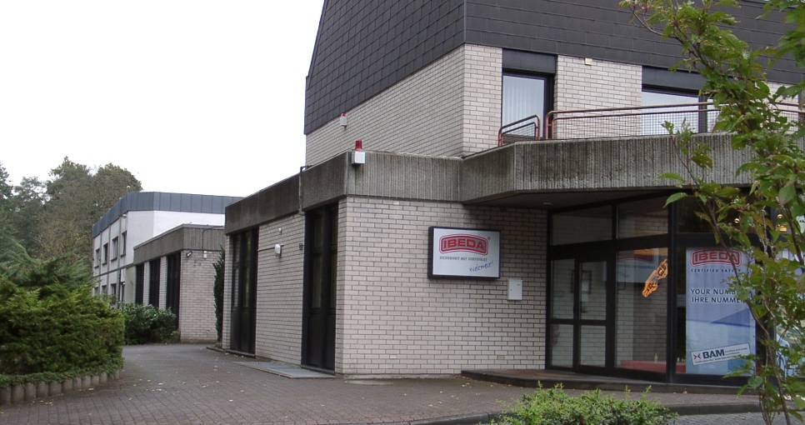
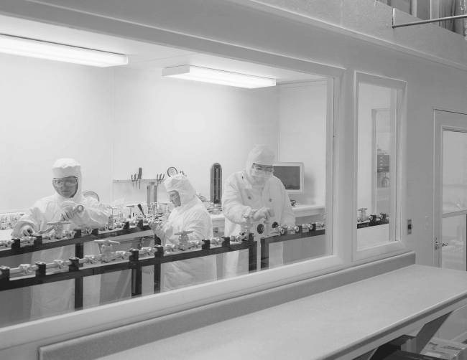
Manufacturing facilities in the U. S. and Europe
Manufacturing line is “State of the Art”
Market Leader with 45+Years of Experience in Gas Safety
Sales in more than 85 Countries
Neustadt Wied, Germany
Serve compressed gas users in 100 countries
Westlake, OH

Slide 8
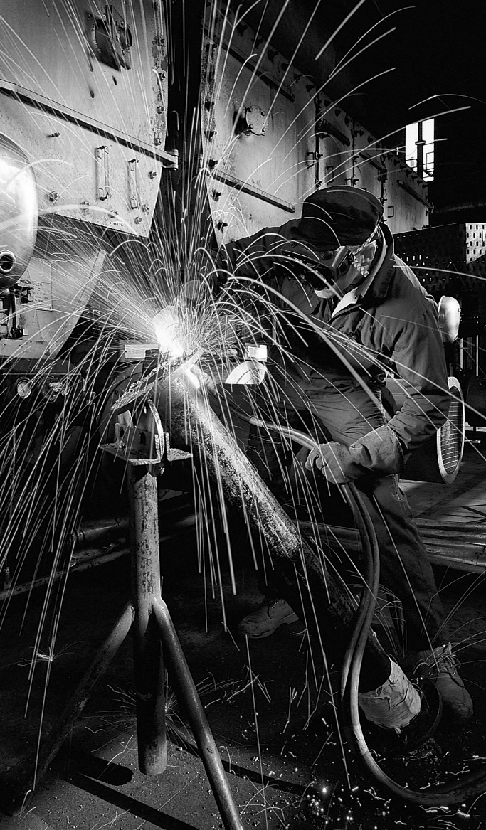
Just a note
This program is informational only and does not certify or qualify anyone in the use of Oxy-Acetylene or Oxy-Fuel Gas burning or welding.
For the proper use of your equipment, please contact your supplier or manufacturer

Slide 9
Which Gas is the Most Hazardous in the Work Place?
Propane
Natural Gas
Oxygen
Air
Acetylene

Slide 10
Answer: They are all hazardous!
Safety Training is Essential
Oxygen is the most hazardous because it is most misunderstood.
Many employees think “Oxygen is ordinary air”. It is most assuredly NOT AIR!

Slide 11

Properties of Oxygen
Oxygen is colorless, odorless, tasteless, it supports life and combustion. It makes up about 1/5 of the air we breathe (20.99%).

Slide 12
Major Uses of Oxygen
Maintenance
Heating, welding & cutting
Combustion Supporting (used extensively in the manufacture of steel and in space program)

Slide 13
Triangle of Combustion
Oxygen
Heat
Fuel
Oxygen lowers the kindling point, increases the speed, and temperature of combustion.

Slide 14
High pressure cylinders are
“sleeping giants”

Slide 15
Hazard of recompression
Open all high pressure valves slowly.

Slide 16
Warning!
X
USE NO OIL in, on, or around oxygen.
Most equipment is lubricated for life.
Only use oxygen compatible leak testing solution such as Applied #1109-1023 and sealants like Applied Telfon tape #1100-9910 which meet military specifications for oxygen compatibility

Slide 17

Never use oxygen……….
in pneumatic tools- the oil and the gas pressure friction can cause a fire or explosion
in oil pre-heating burners- these burners are set to burn with 21% oxygen to air ratio
to start internal combustion engines- gasoline is flammable enough with 21% oxygen available
to blow out pipelines- Leftover flammable or combustible vapors may still be present to cause an explosion
to dust off clothing or work area- the oxygen will remain present in the cloth fibers causing them to be more flammable
to create pressure
for ventilation
Notes:
Due to the high pressure under which oxygen is bottled, cylinders must always be handled with great care. The potentially violent reaction of oil, grease or all other contaminants in the presence of oxygen cannot be overstressed. Serious injury may easily result if oxygen is used as a substitute for compressed air.

Slide 18

Something to think about……
Every time you use the
oxy-acetylene or oxy-fuel gas equipment ,
if safety guidelines
are not followed, it would
be the same as handling
TNT ready to go
off…….
Now let’s talk about other gases

Slide 19
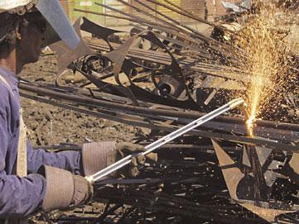
Opportunity to Improve Safety and Productivity
Only 5% of Torches & Regulators are Equipped with Flashback Arrestors

Slide 20
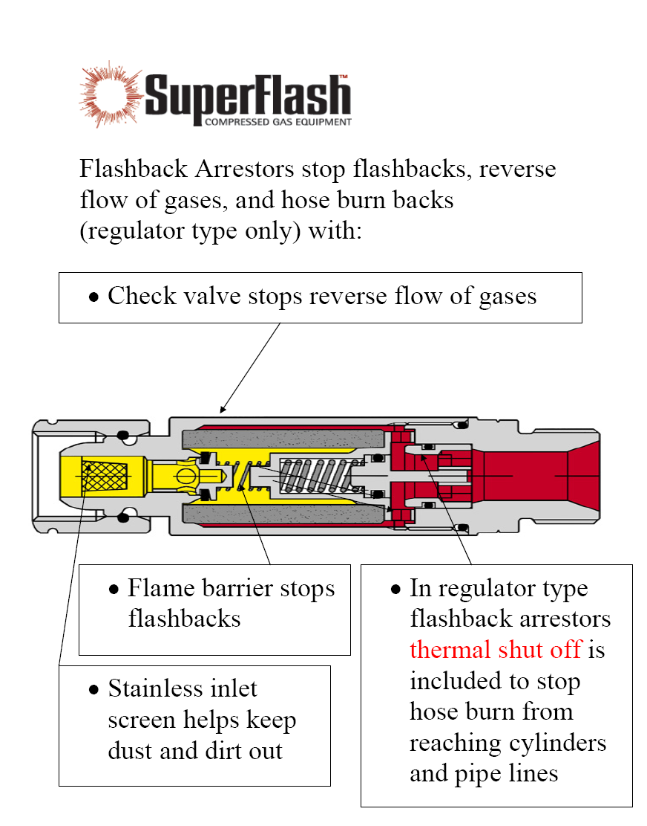

Slide 21
Frequently Asked Questions
Why do I need flashback arrestors?
Why aren’t they built in to the torch or regulator?
Why aren’t they required by OSHA?

Slide 22

What is acetylene
Acetylene is a compound of Hydrogen and Carbon (C₂H₂) a member of the hydrocarbon gases
Explosive range is 3.0 to 93%
Needs only 10% of oxygen to ignite
Produced when calcium carbide is mixed with water
It is an unstable gas, will violently decompose when in a pure state above 15 psi
Has a burning temperature of 4,600º F, 5,700º F when burned with oxygen
Auto-ignition temperature is 763º - 824º F, this means if acetylene reaches 30 psi in a free state, it can explode by itself without a spark or flame being present
Remember, acetylene is a very dangerous gas
Notes:
Acetylene
Acetylene is a compound of carbon and hydrogen (C₂H₂). It is a versatile industrial fuel gas used in cutting, heating, welding, brazing, soldering, flame hardening, metal-lizing, and stress relieving applications.

Slide 23
Why doesn’t acetylene explode in the bottle
Acetylene burns in air readily, and is most safely hand- led/stored in cylinders filled with crushed firebrick wet with acetone.
Acetylene happens to dissolve readily into acetone, and the dissolved gas is no longer in contact with gaseous O₂ (which does not tend to dissolve in acetone) and therefore is not as prone to decomposition by O₂.
The firebrick also helps by minimizing the free volume of the cylinder, cooling and controlling any thermal decomposition before it gets out of control (each decomposition of acetylene gives off heat).
Acetylene cylinders must, therefore, be refilled only by authorized gas distributors. Acetylene cylinders must never be transfilled.

Slide 24
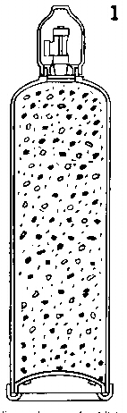
How are acetylene bottles constructed
Usually are steel construction
Filled with a porous material to allow the acetone to dissolve the acetylene, which makes it stable
Porous filler(8-10%), Acetone(42%)
Acetylene gas(36%),
Reserve volume-70º F(10-12%)
Never allow a tank to go empty
  Oxygen may back pressure into the bottle
Comes in various sizes
Must always be stored upright
  This prevents the acetone and acetylene
  from separating
Should not be stored below freezing
  Acetone may come out instead of acetylene
  and may clog the regulators
Notes:
POROUS FILLER 8%tolO%
The filler, which completely occupies the steel shell, is 90%to 92% composed of millions of interconnected pores.
ACETONE 42%
Acetone equal to 42% of the internal volume is dispersed throughout the filler.
ACETYLENE GAS 36%
The acetylene gas is uniformly absorbed by the acetone. The resulting mixture occupies 78% of the internal volume.
RESERVE VOLUME AT 700 F 10%tol2%
Since acetone and acetylene gas will expand as temperature rises, a safety reserve must be present even at 1500 F.

Slide 25
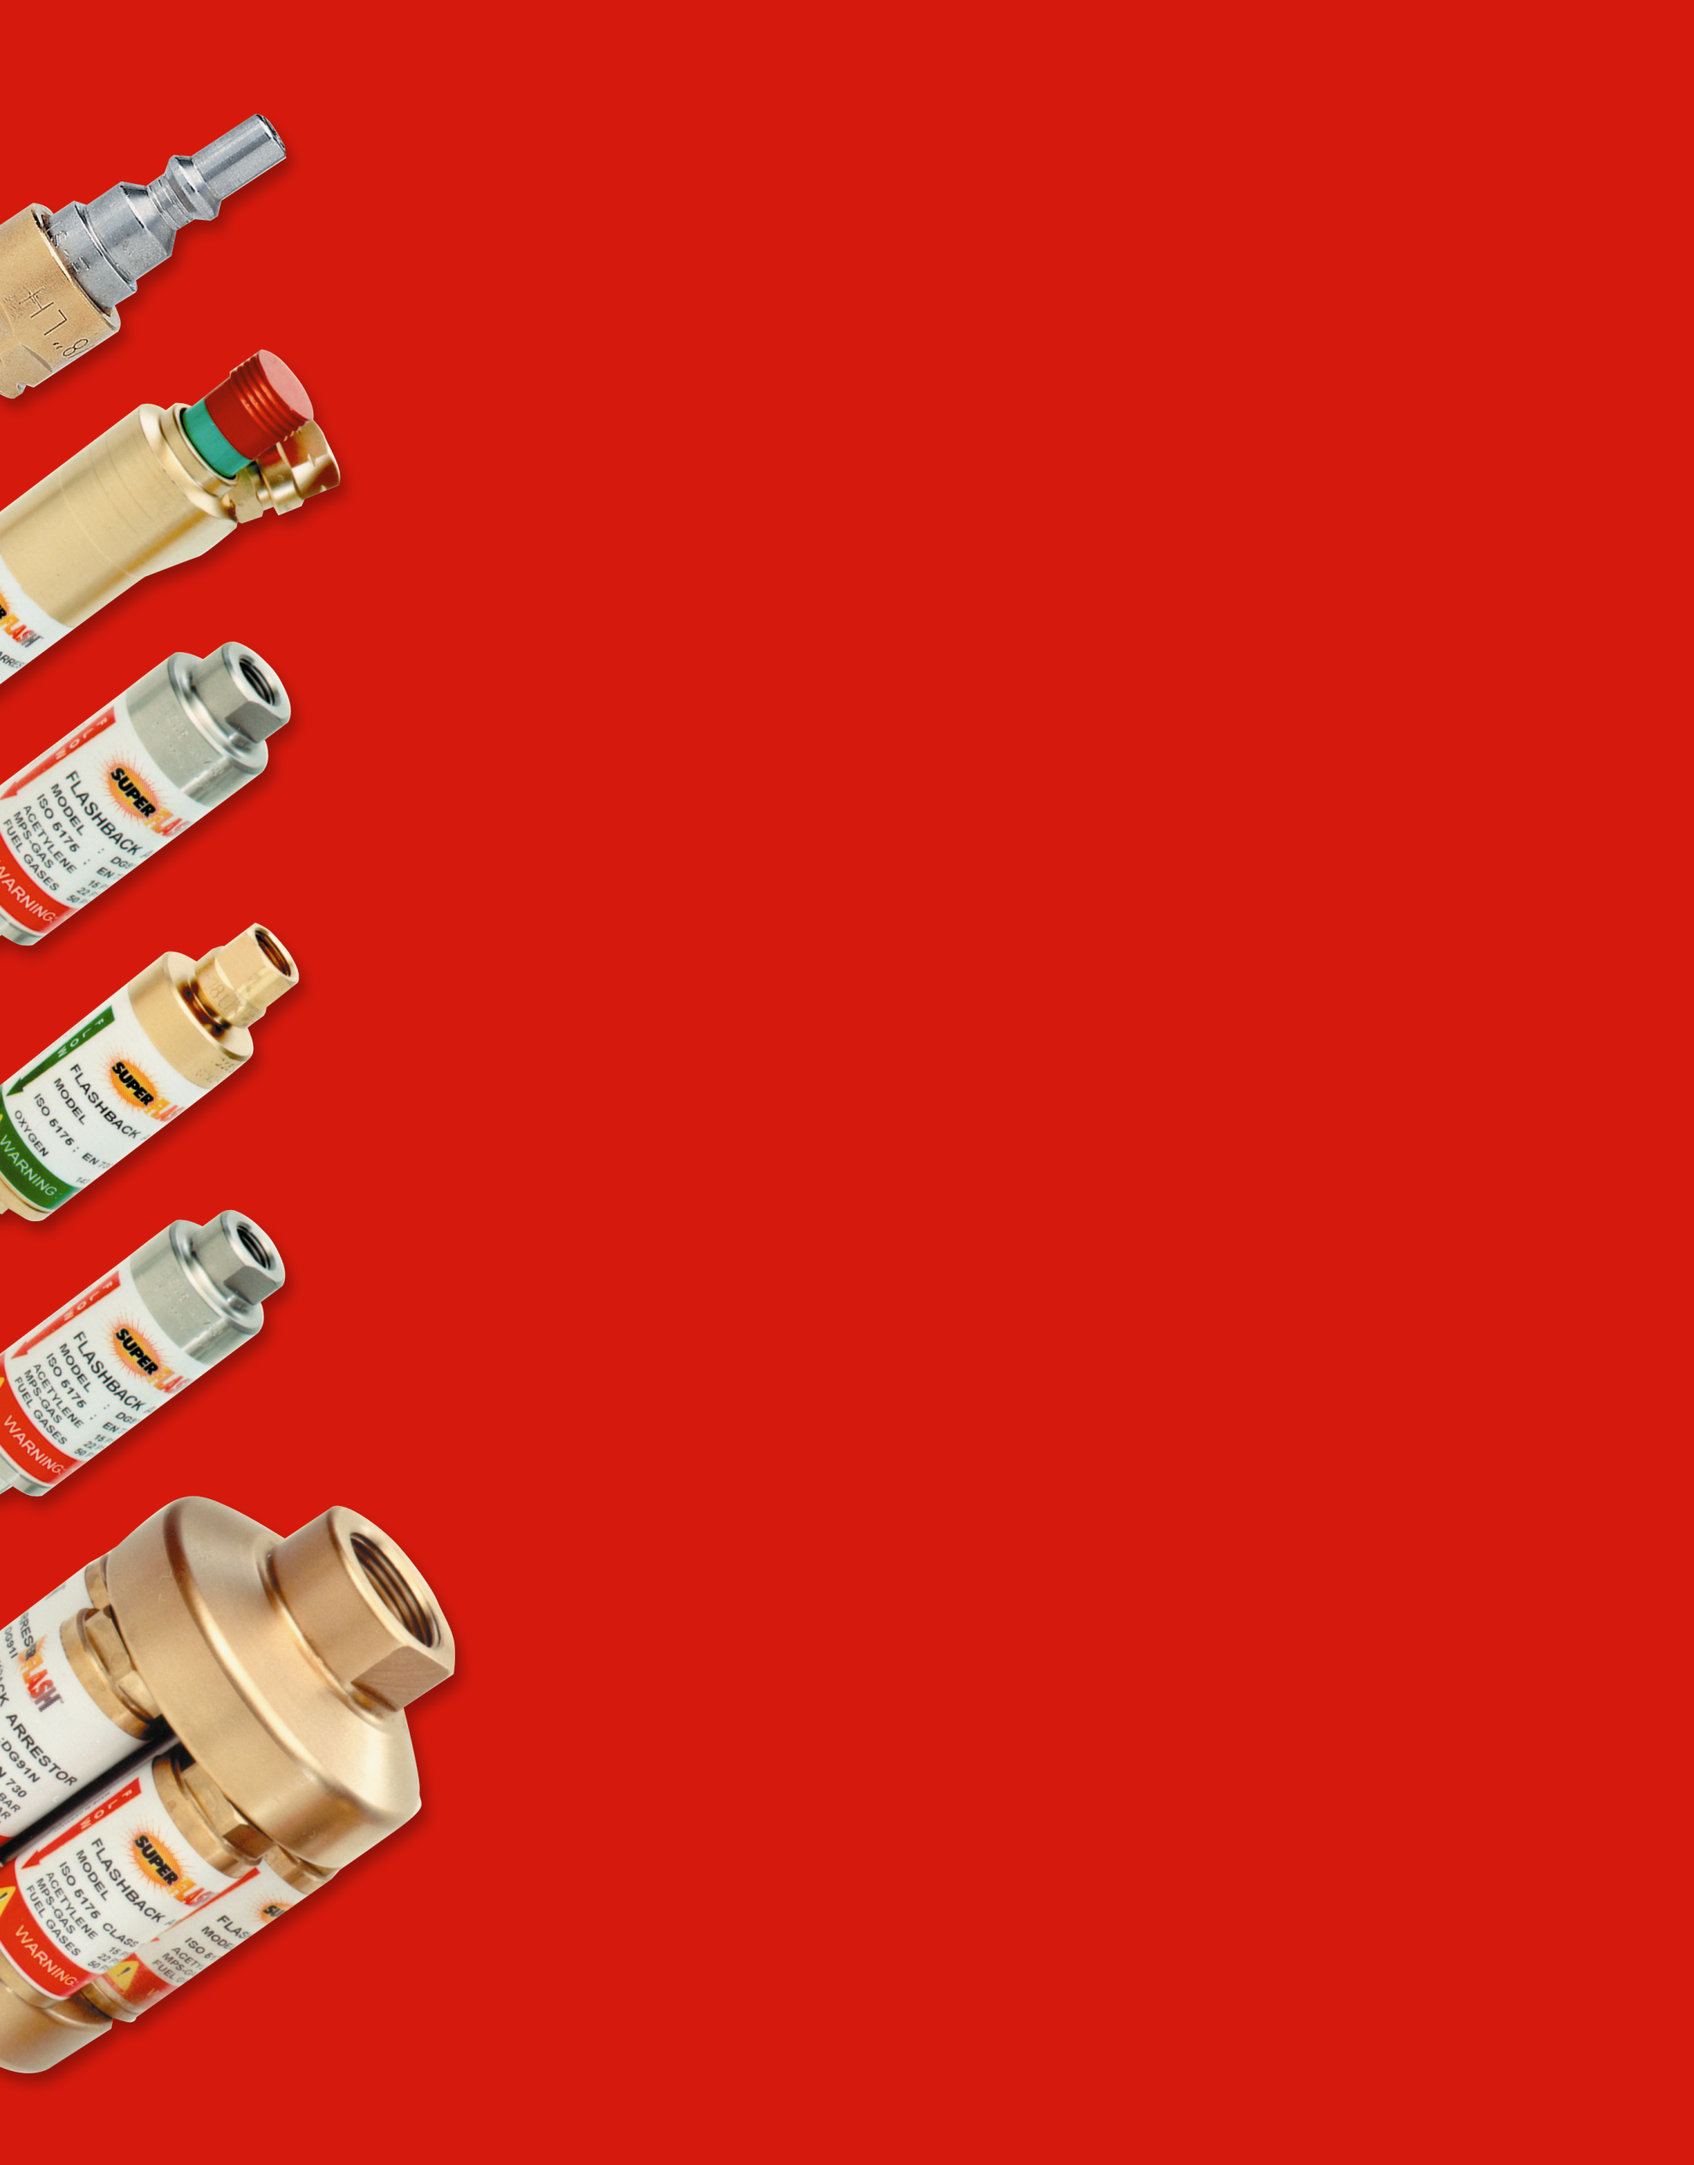
What are alternate fuel gases?
Natural gas
  Cadillac of fuels available at Kia prices
  Requires 1:1.6 parts of oxygen
Propane
  2,642 BTU vs. Acetylene 1,642 BTU
  Less costly than Acetylene
  Heavier than air
MAPP and other fuel gases

Slide 26
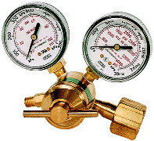
Care & maintenance of the Gas Regulators
The internal working parts of the regulator are precision units. Only qualified technicians should clean or repair a regulator
The Low pressure gauge
  Indicates the delivery pressure to the hoses & torch
The High pressure gauge
  Indicates the pressure from tank
The Inlet Connections
  Oxygen are right hand thread/Acetylene are left hand thread
  Keep free of oil, grease, & dirt
The Pressure adjusting screw
  Turning clockwise allows the gas allows to flow
  Turning counterclockwise reduces or stops the gas flow
Notes:
Regulators
Oxygen and fuel pressure regulators are attached to the cylinders or manifold outlets to reduce high cylinder or supply pressures to suitable low working pressures for cutting and welding applications.
Pressure Adjusting Screw
The regulator adjusting screw controls the delivery pressure of the gas to the hose.
The internal working parts of the regulator are precision units. Only qualified technicians should clean or repair a regulator.

Slide 27

Some more info on regulators
Warning -Always keep the regulator free of oil, grease and other flammable substances
Never use oil or grease on the regulator, cylinder or manifold connection
DO NOT change the inlet connection on a regulator in an attempt to use the regulator for a different gas service
Never stand in front or behind a regulator when opening the cylinder valve

Slide 28


Check valves
The purpose of an internal check valve is to reduce the possibility of reverse flow gas.
It is not intended to act as a fire stop or flashback arrestor!
Ensure that the internal check valves are working properly by testing at least every six months, more often if the hoses are frequently removed from the torch. No inlet filter.
Spring activated
Gas flow
Once flow pressure decreases, valve will closes preventing back flow of gas
Flow of gas keeps valve open

Slide 29
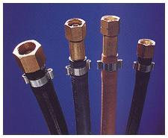
The Hoses
The hoses are usually color coded, but not always
  Oxygen(green)
  Acetylene(red)
  Be careful not to use other hoses, such as air lines, LP gas, etc.
They are neoprene over braided inner section
  Be careful around sharp objects, they can be cut very easily
They are constructed of flame retardant materials, but will burn if there is a flashback or exposed to sustained heat
Hoses are graded
  Make sure you are using the right hose for the right gas

Slide 30

More hose stuff
Keep welding hoses clear of any failing metal, slag or sparks.
Never allow hoses to become coated with oil, grease or dirt. Such coatings could conceal damaged areas.
Examine the hoses before attaching to welding torch handle or regulators.
If cuts, burns, worn areas or damaged fittings are found, replace the hose.
Completely replace welding hose if it contains multiple splices or when cracks or severe wear is noticed.

Slide 31

What size cutting-tip do I need?
The type of torch you are using and the thickness of material being cut determine the proper size cutting-tip for use in oxy-acetylene flame cutting
Always make sure your equipment is rated for the size tip you have selected.
A tip with too much capacity for the equipment can starve or choke the tip. This causes overheating of the head and a flashback may result.
A damaged seating surface on either the tip or the head can create a dangerous condition, resulting in a fire or flashback. This may damage the cutting attachment.
If the seating surface of a tip becomes damaged, DO NOT use it. Discard the damaged tip.
If the head requires repair, take the torch to a qualified repair technician.

Slide 32



MSHA Regulations
Laws & Regulations
for
Oxy-Acetylene & Oxy Fuel Gas Use
OSHA Requirements
ANSI, AWS, and CGA

Slide 33
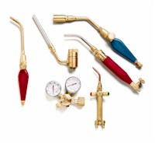
Let’s Finish With Some Final General Safety Tips
Never allow oxygen to contact oil, grease or other
flammable substances
Never mix brands
Purge the lines before and after usage
Always wear protective clothing
Use proper eye protection

Slide 34
If flashback occurs, immediately turn off the O₂, then the acetylene, and allow unit to cool
Always work in a well ventilated area
Always light the acetylene first
Oxygen cylinders must be opened the whole way
Use an approved striker, never use matches or cigarette lighter
Use the proper regulator for each specific gas
Only qualified technicians should repair a regulator
Keep regulators free of oil, grease and other flammable substances

Slide 35

General Safety Tips
Keep regulators free of oil, grease and other flammable substances
Check valves stop reverse gas flow, they do not act as a fire stop
Never starve a tip, this can cause a flashback
Always keep cylinders in an upright position
Never stand in front or behind a regulator when opening the cylinder valve
Do not open acetylene valve more than 1 ¹/₂ turns
Always make sure area is safe and flammable free

Slide 36





Safety Checklist for Getting Started
What is the necessary safety equipment you need?
Proper Eye protection
Appropriate gloves
Clothing free of grease & oil
Clean work area
Proper Task Training
Fire extinguisher

Slide 37

Frequently Asked Questions
Are flashback arrestors expensive?
Why is high gas flow capacity important?

Slide 38
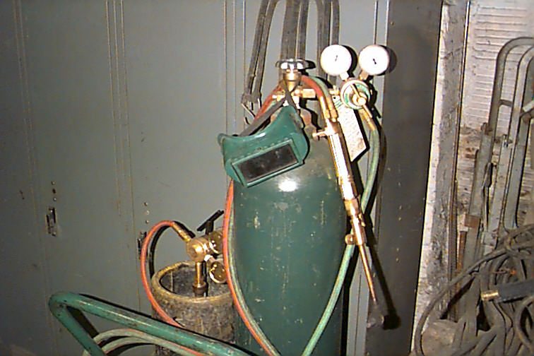
Thank you for attending the
O. E. Meyer Safety Seminar

